Slide 1
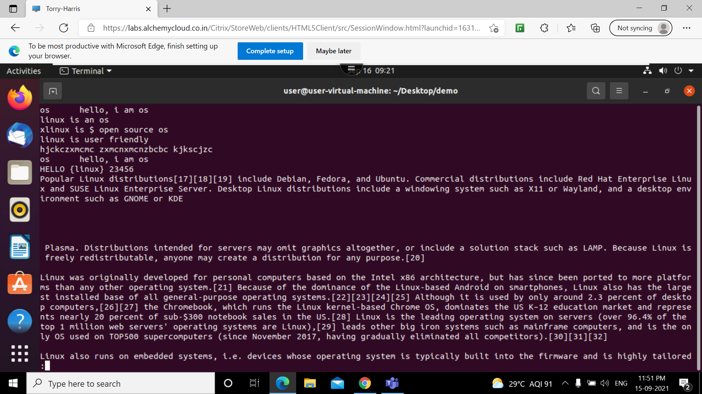
less
THIS COMMAND IS USED TO LOAD SINGLE PAGE AT A TIME

Slide 2
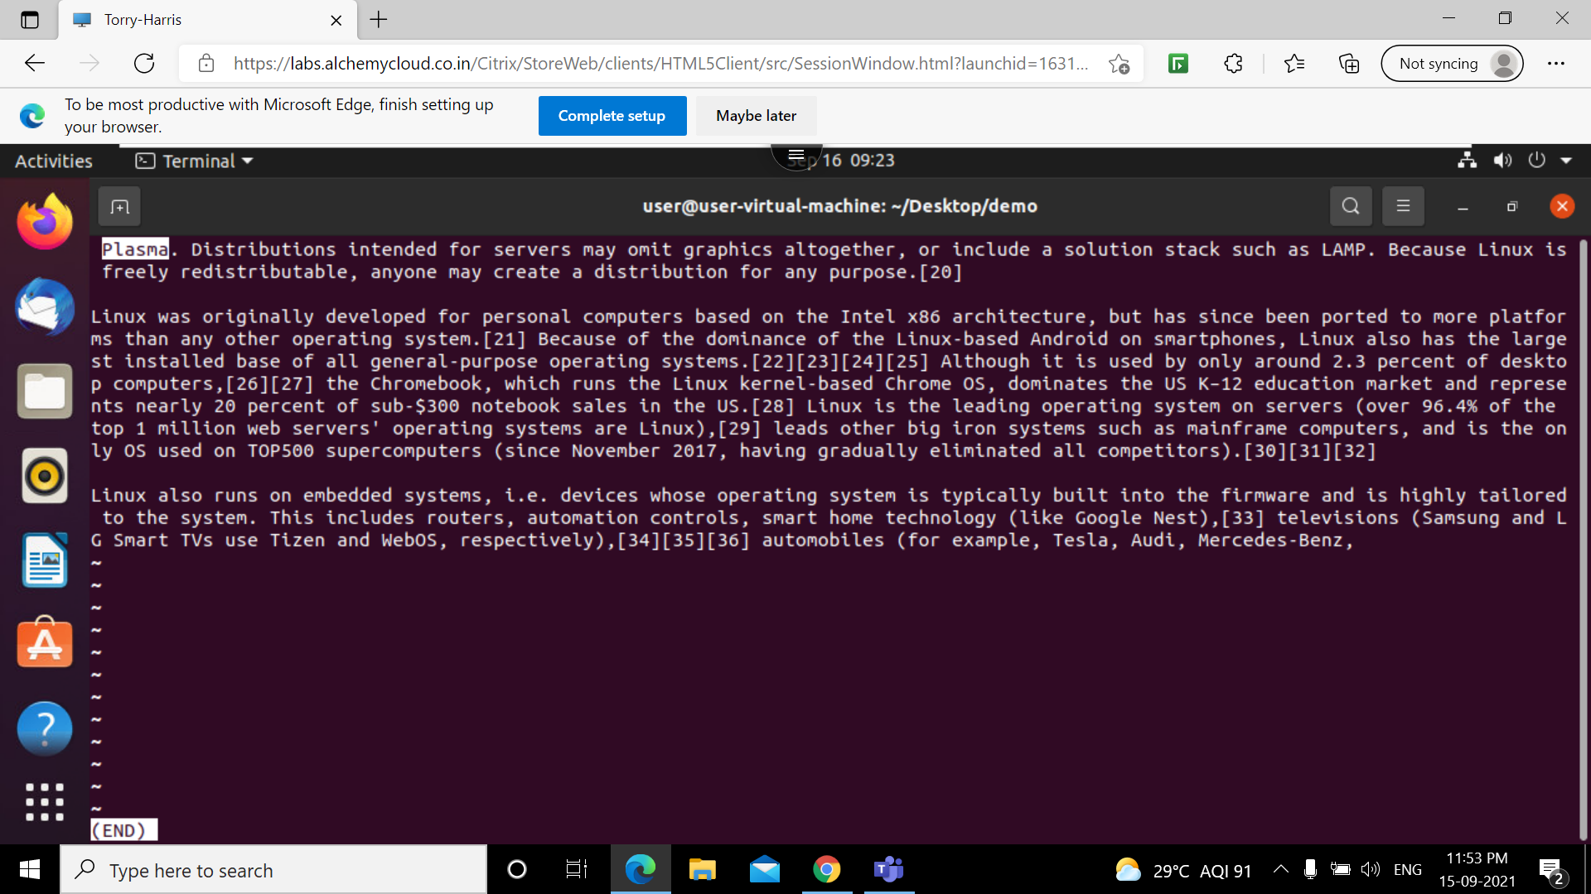
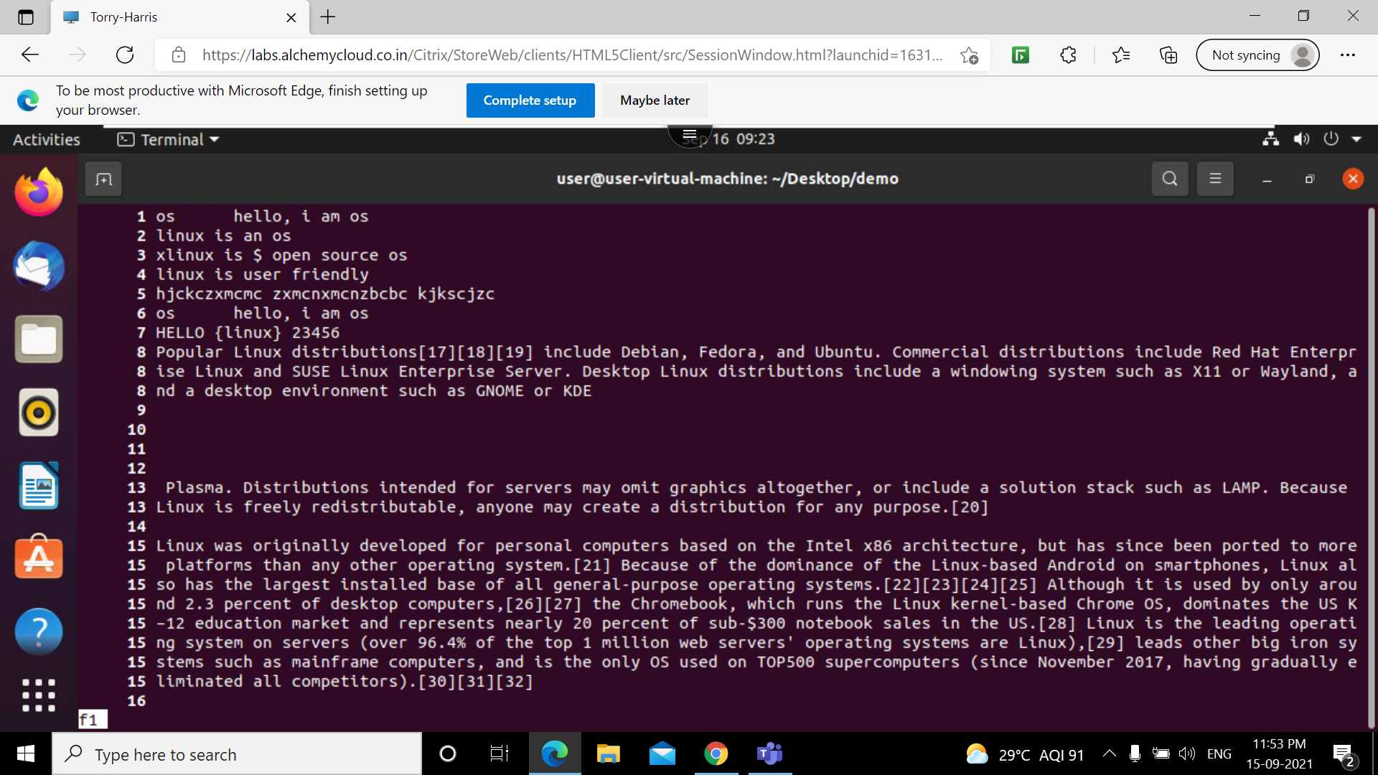
less

Slide 3
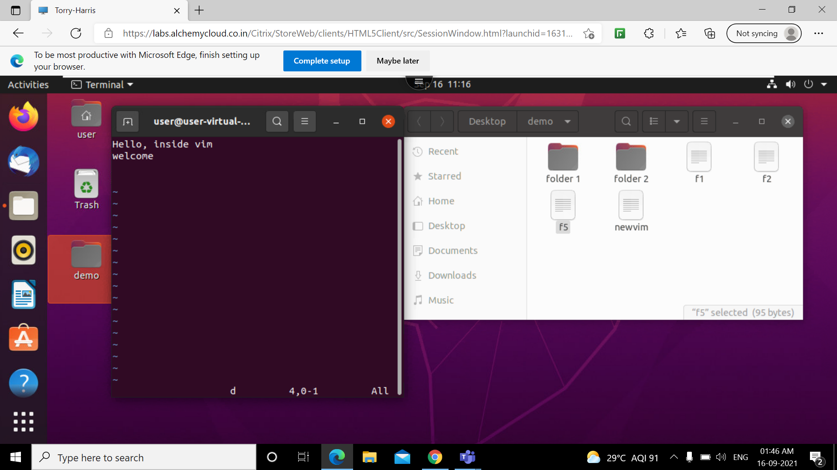
vim
Vim is a text editor for Unix that comes with Linux. It is known to be fast and powerful, partly because it is a small program that can run in a terminal. It is mainly because it can be managed entirely without menus or a mouse with a keyboard

Slide 4


:w and :r filename
These commands are used to save the content and to copy the content of existing file

Slide 5
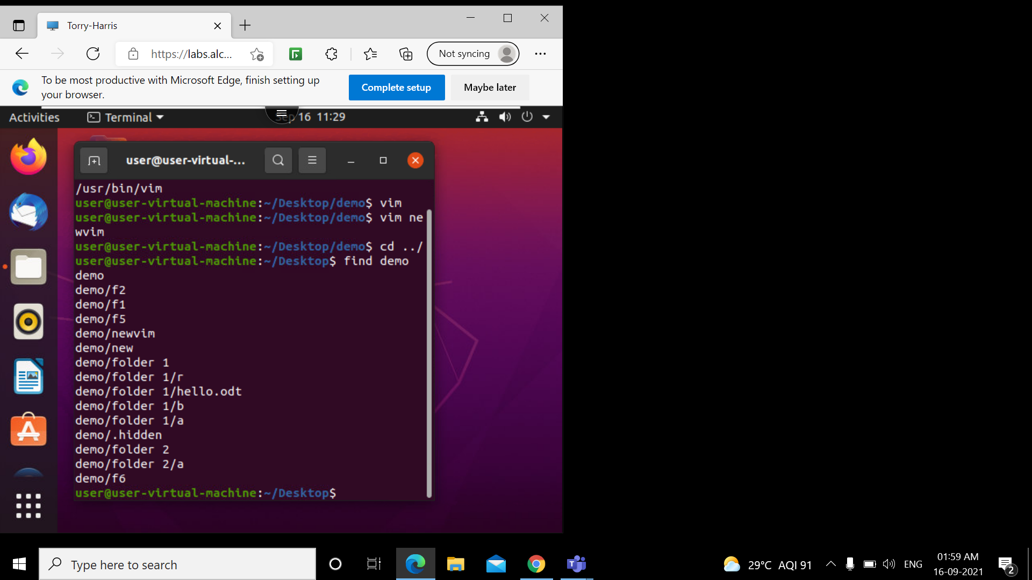
find
The find command is used to search and locate the list of files and directories based on conditions you specify for files that match the arguments. find command can be used in a variety of conditions like you can find files by permissions, users, groups, file types, date, size, and other possible criteria.

Slide 6
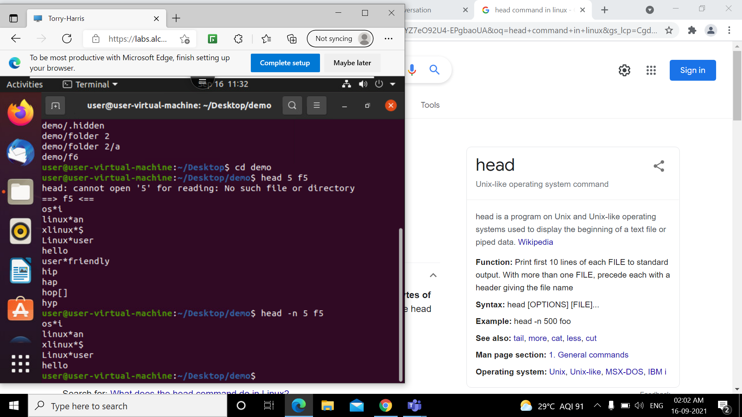
head
The head command writes to standard output a specified number of lines or bytes of each of the specified files, or of the standard input. If no flag is specified with the head command, the first 10 lines are displayed by default

Slide 7
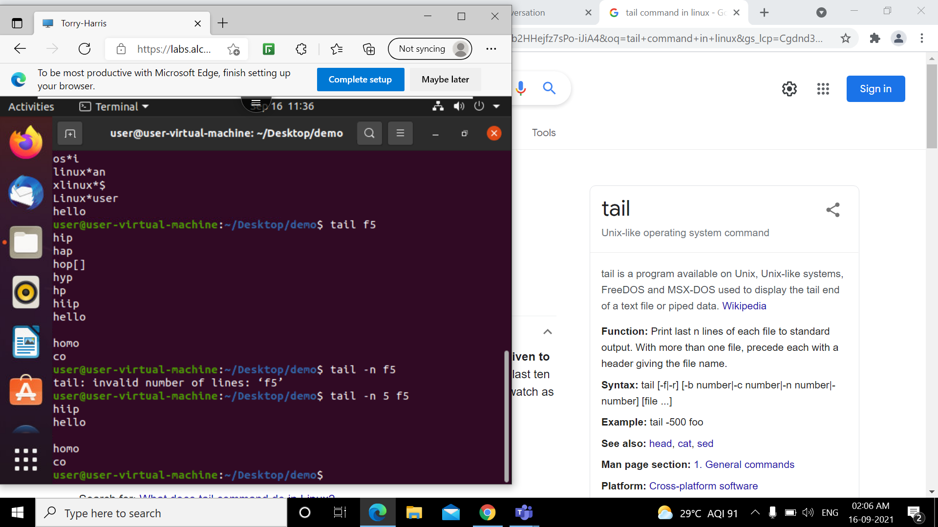
tail
The tail command is a command-line utility for outputting the last part of files given to it via standard input. It writes results to standard output. By default, tail returns the last ten lines of each file that it is given.

